Slide 1
Optical Side-channel Simulation from the Backside of An AES Chip
Presenter: Henian Li
Date: 08/11/2023

Slide 2

About Me
B.S. – Integrated Circuit Design and Integration System, Hefei University of Technology, China, 2019
Joined the University of Florida as M.S. student in August 2019, major in ECE
Joined my current lab in Spring 2020, then transferred to Ph.D. program under Dr. Mark Tehranipoor’s supervision, in Summer 2020.
Joined Ansys as intern at Summer 2022 and 2023, under Dr. Norman Chang’s supervision
Research interests:
Hardware security and trust, physical attack assessments, secure-scan
Potato stew recipes
I really enjoyed working at Ansys this summer, I’ve learned a lot and met so many
awesome people!!

Slide 3
Outline
Backgrounds of Hardware Security, and Side-Channel attack
Motivations
Overall Framework
About AES, and Our Testcase
Totem for NMOS Current Traces
Photon Emission Modeling and Photon Image Calculation
Correlation Power Analysis Approach, on Optical Case
Experimental Results
Automated Exploration Flow with optiSLang
Conclusion and Future Work

Slide 4
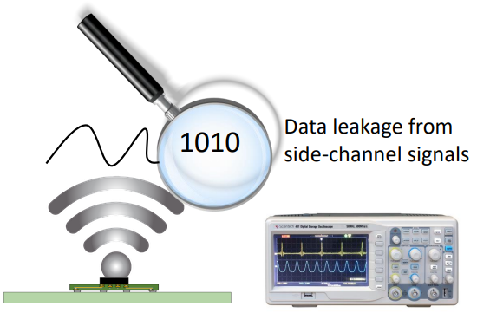
What is Side-Channel Attack?
Extraction of secrets through physical communication channels other than intended
Power consumption
Power noise emission
Electromagnetic emission
Thermal emission
Optical photon emission
Side-channel leakage can be “listened” and analyzed
A system is as secure as its weakest link
Notes:
50 years ago, computing devices are not for everyone use. When it comes to security,
But now, everyone got physical access to computing devices, IoT device, mobile phones, laptop, embedded systems, they are everywhere. And every single one of them may store sensitivity information that people don’t share to public.
When you text an imessage, it’s encrypted. scan your face or fingerprint, store them as an ID, it’s encrypted. Whenever it’s an encryption, whether what form it is, it eventually go through the hardware.
For implementations of crypto algorithm, by implementation
Side-channel: We could try to observe the parameters coming out of the chip during execution, try to make sense of it, try to break the chip
Remember: A system is as secure as its weakest link.
So even though we have the strongest crypto algorithms, the implementations may not be as good as those algorithms. In many cases, the implementations become a weakest point of the system.
Basic idea of side-channel:
By side-channel, we don’t try to break it mathematically, what we do is: given some plaintexts, maybe some ciphertext, and given the side-channel activities , (EM, power, optical, etc.), and try to establish the relationship between that activity and the input, or output, then maybe try to conclude what would be the key running through that? Because through all of your observation, the secret key is always involved, the key is always making impacts on your power. Your EM, all of these activities.

Slide 5
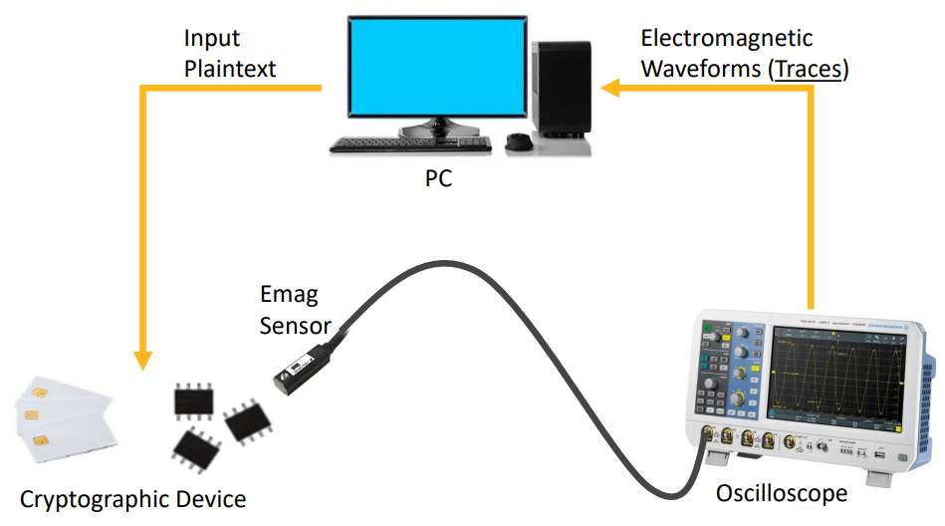
Side-Channel Leakage Measurement
Notes:
For EM SCA: you need hardware with crypto algorithm (crypto IP, SoC, processor running it, FPGA, etc.) You need: probe, function generator, oscilloscope to collect traces, and PC for storing and analysis. Different from crypto analyst, they observe the input and output ciphertext. You observe input and these power traces, and that’s your output. Then like I said, try to establish the relationship between them. About crypto key: often generated by TRNG, and stored securely in Trusted Execution Environment (TEE, just an isolated zone) or a Trusted Platform Module (TPM, a separate chip). And might not be frequently changed. The changing frequency highly depends on different chip/company’s security specification or security policy when they are making chips. A rough answer would be quarterly or annually.

Slide 6
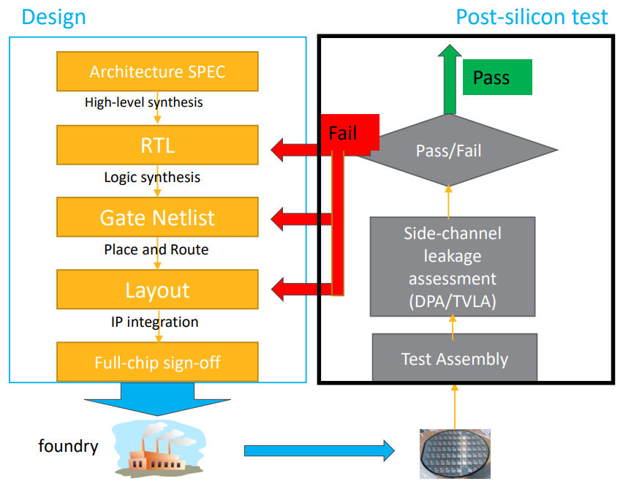
Motivation for Pre-silicon Side-channel Leakage Analysis
Currently Side Channel validation is conducted with security labs
Too primitive for basic testing, and expensive/slow process for high security critical applications
Information leakage mechanism is a black box for chip designers
Too late to make design changes after silicon is found leaky

Slide 7
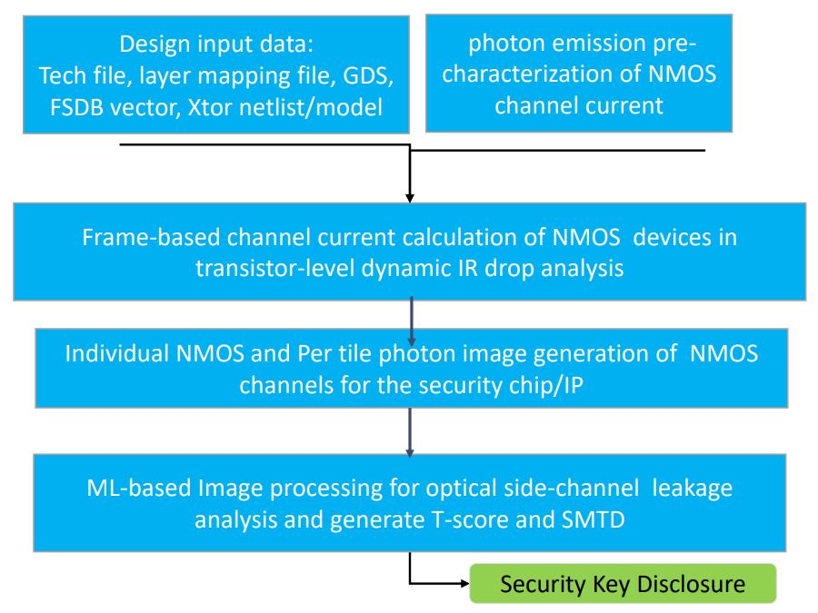
Overall Framework

Slide 8
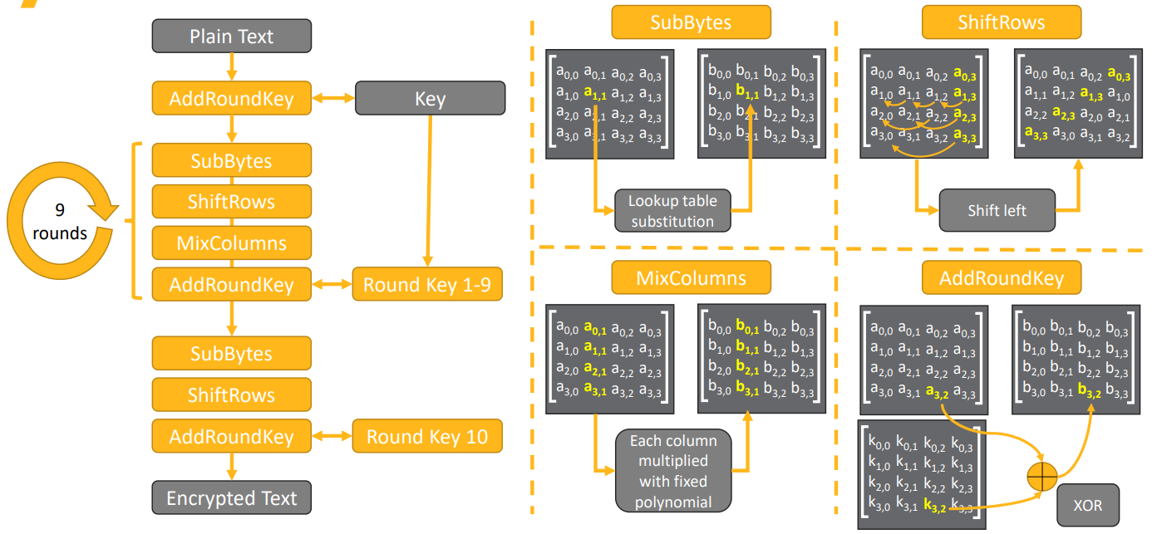
AES-128 Crypto Algorithm
Our testcase is an AES128 implementation from Kobe University researchers

Slide 9
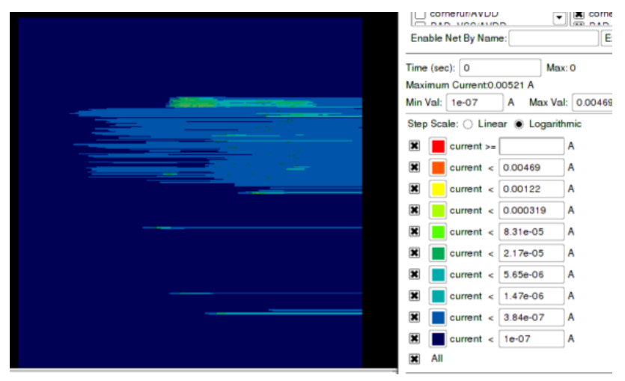
Totem for NMOS Current Traces
Frame-based channel current calculation of NMOS devices in transistor-level dynamic IR drop analysis
Per NMOS Channel current simulation is derived from transistor-level dynamic IR drop simulation in Totem to get the per-frame (such as 10nsec) current distribution heatmap, given a switching scenario as described in FSDB.

Slide 10
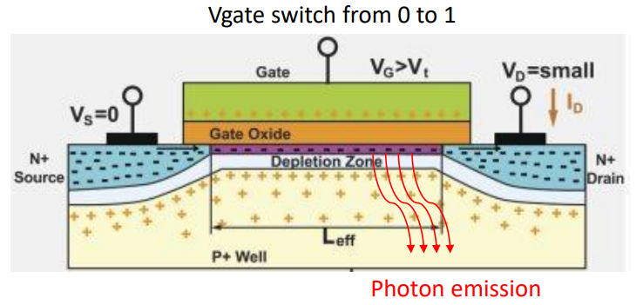
Device Photon Emission
Photon emission happens in NMOS more prominently compared to PMOS
Photon emission is observed for NMOS when a channel current (Ids) is present
Physical process: hot carriers accelerated by high fields at the drain PN junction
The amount of photons depend on device electro-photonic physics, device geometry parameters (i.e. W/L), and channel current density
The photons can be captured by InGaAs cameras such as in PHEMOS-1000, so that the device activity is reflected

Slide 11
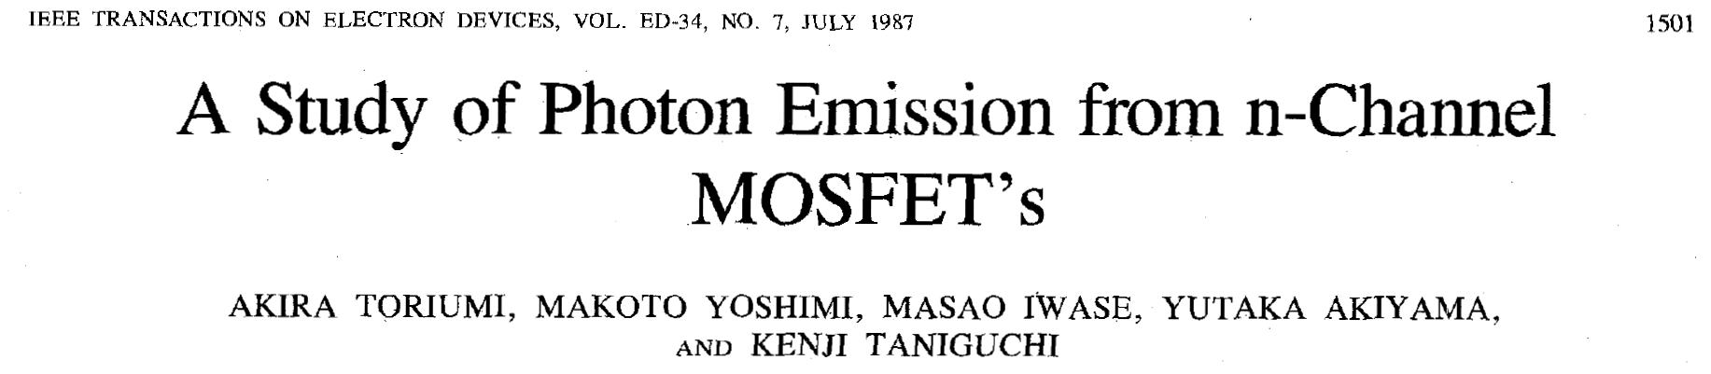
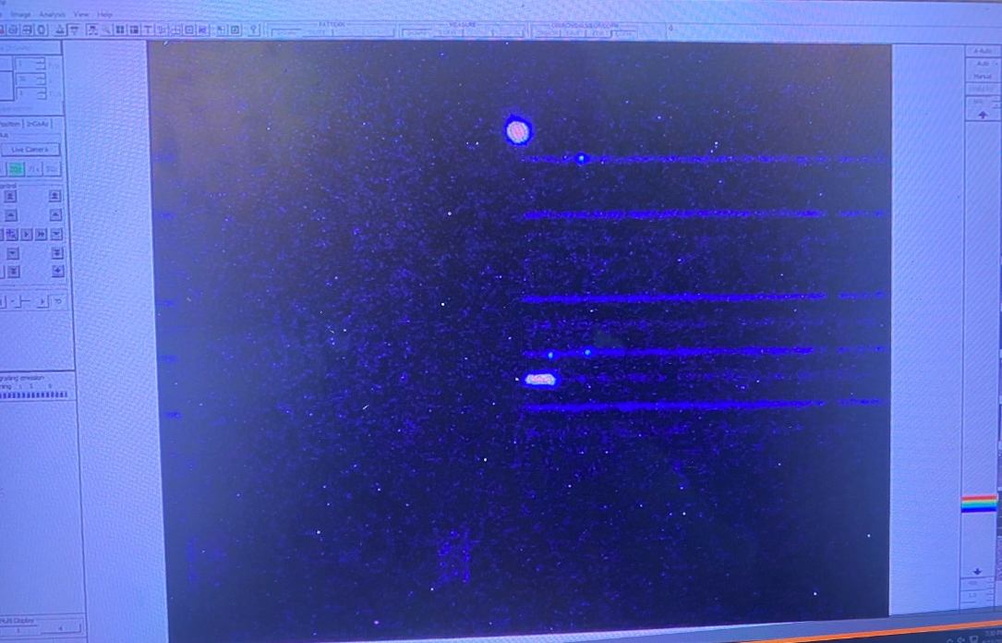
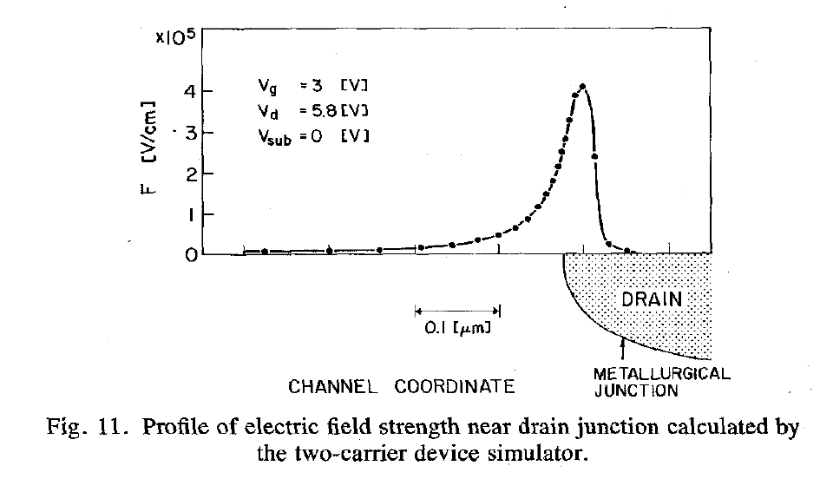
Photon Emission Modeling
Photoemission is observed for NMOS devices when a channel current (Ids) is present
Physical process: hot carriers accelerated by high fields at the drain PN junction
Photon emission photos taken by PHEMOS-1000
Toriumi et al., IEEE TED 34, p1501 (1987)

Slide 12
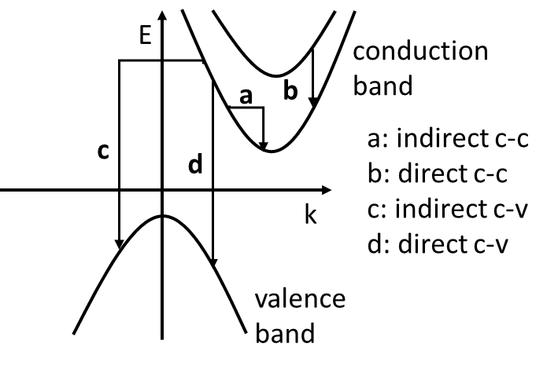
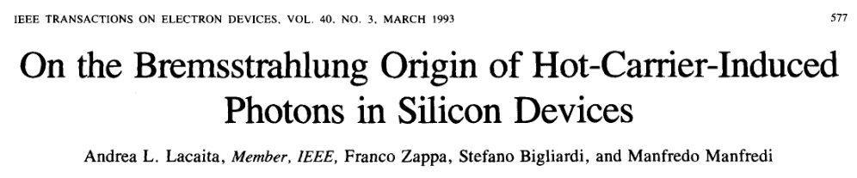
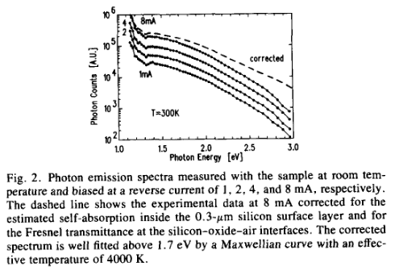
Hot carriers
Different relaxation paths could be responsible
Intraband
Indirect c-c: impurity assisted (IA) or bremsstrahlung process (a)
Direct c-c: radiative emission from higher sub-bands (b)
Interband
Indirect c-v: phonon assisted (PA) e-h recombination (c)
Direct c-v: electron-hole recombination (d)
Early theory assumed IA c-c; spectral analysis & later theory suggests direct c-c
Intraband processes dominate, interband is negligible
Lacaita et al., IEEE TED 40, p577 (1993)

Slide 13
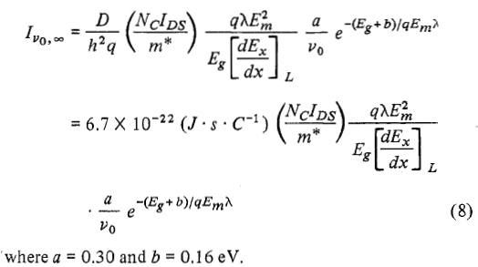
Formulation from Tam & Hu
Integrating over frequency
Tam & Hu, IEEE TED 31, p1264 (1984)

Slide 14
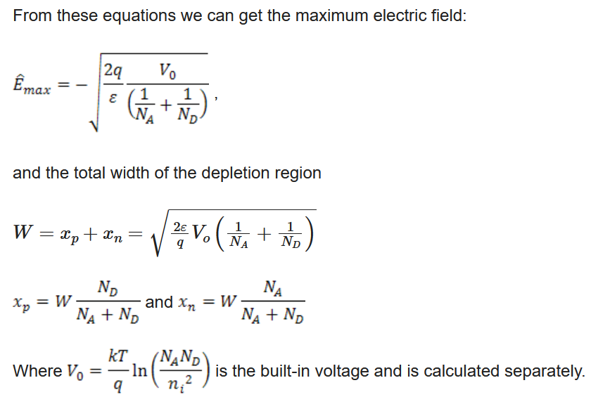
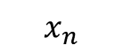
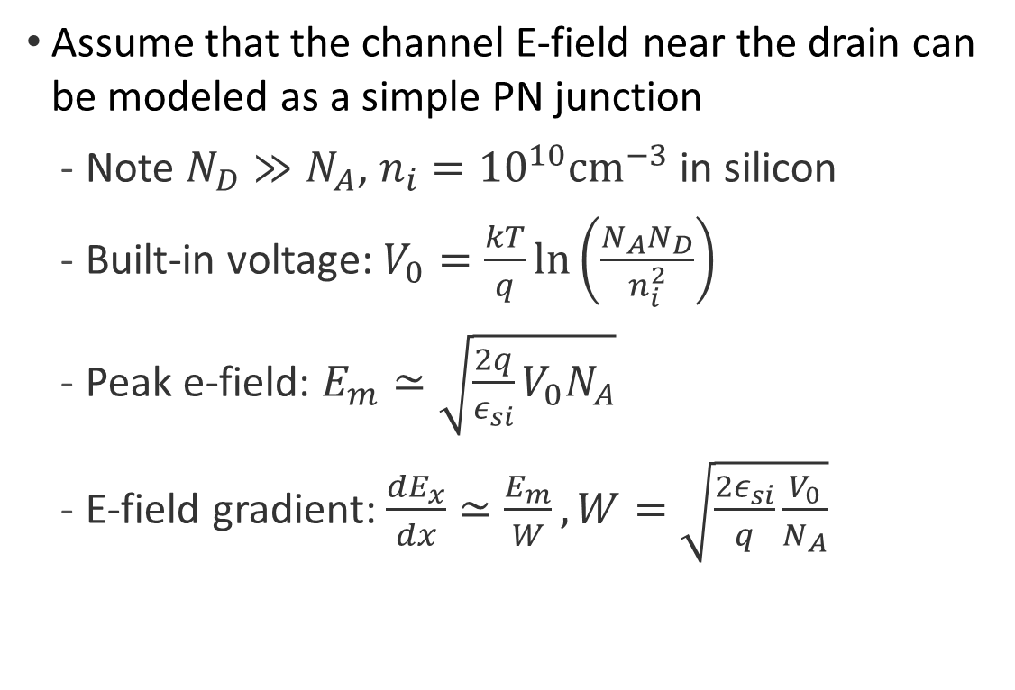
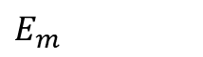
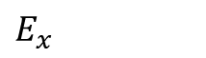
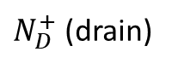
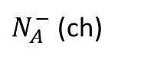
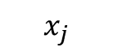
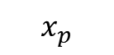
Modeling $E_{m}$ and $dE_{x}/dx$
Assume that the channel E-field near the drain can be modeled as a simple PN junction
Note $N_{D}≫N_{A}$, $n_{i}={10}^{10}cm^{−3}$ in silicon
Built-in voltage: $V_{0}=\frac{kT}{q}\ln\left(\frac{N_{A}N_{D}}{n_{i}^{2}}\right)$
Peak e-field: $E_{m}≃\sqrt{\frac{2q}{ε_{si}}V_{0}N_{A}}$
E-field gradient: $\frac{dE_{x}}{dx}≃\frac{E_{m}}{W}, W=\sqrt{\frac{2ε_{si}}{q}\frac{V_{0}}{N_{A}}}$
Channel/drain “diode”
$N_{D}^{+}$ (drain)
$N_{A}^{−}$ (ch)
x
$$E_{m}$$
$$E_{x}$$
x
$$x_{j}$$
$$x_{p}$$
$$x_{n}$$

Slide 15
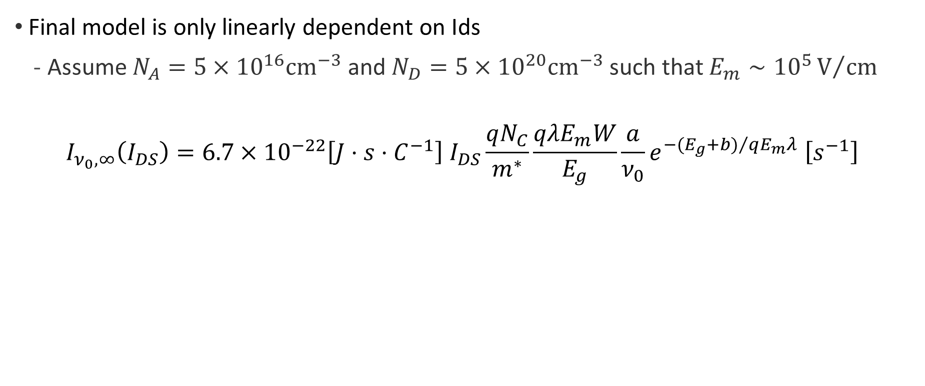
Emission rate model
Final model is only linearly dependent on Ids
Assume $N_{A}=5×{10}^{16}cm^{−3}$ and $N_{D}=5×{10}^{20}cm^{−3}$ such that $E_{m}∼{10}^{5}V/{cm}$
$$I_{ν_{0},∞}\left(I_{DS}\right)=6.7×{10}^{−22}\left[J⋅s⋅C^{−1}\right] I_{DS}\frac{qN_{C}}{m^{∗}}\frac{qλE_{m}W}{E_{g}}\frac{a}{ν_{0}}e^{−{{(E}_{g}+b)}/{qE_{m}λ}} \left[s^{−1}\right]$$
Tam & Hu, IEEE TED 31, p1264 (1984)

Slide 16
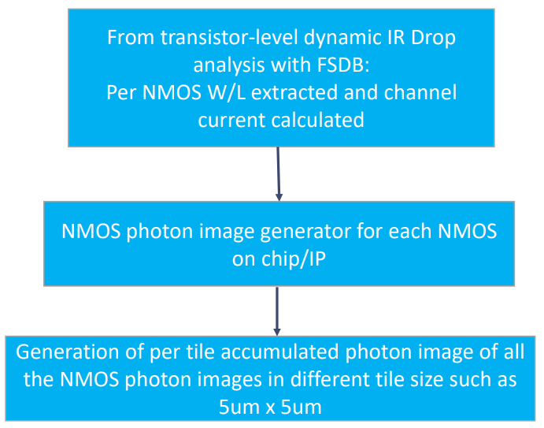
Photon Image Generator
Individual NMOS and per-tile photon image generation of NMOS channels in the security chip/IP
Why tile-based?
Per transistor photon image is very small in size (< 1um), we could accumulate all the NMOS photon image intensity to a representative tile with size controlled by user
To simulate real-life attacks: the attacker scan the layout with a given resolution, and each piece of image got the accumulated info

Slide 17
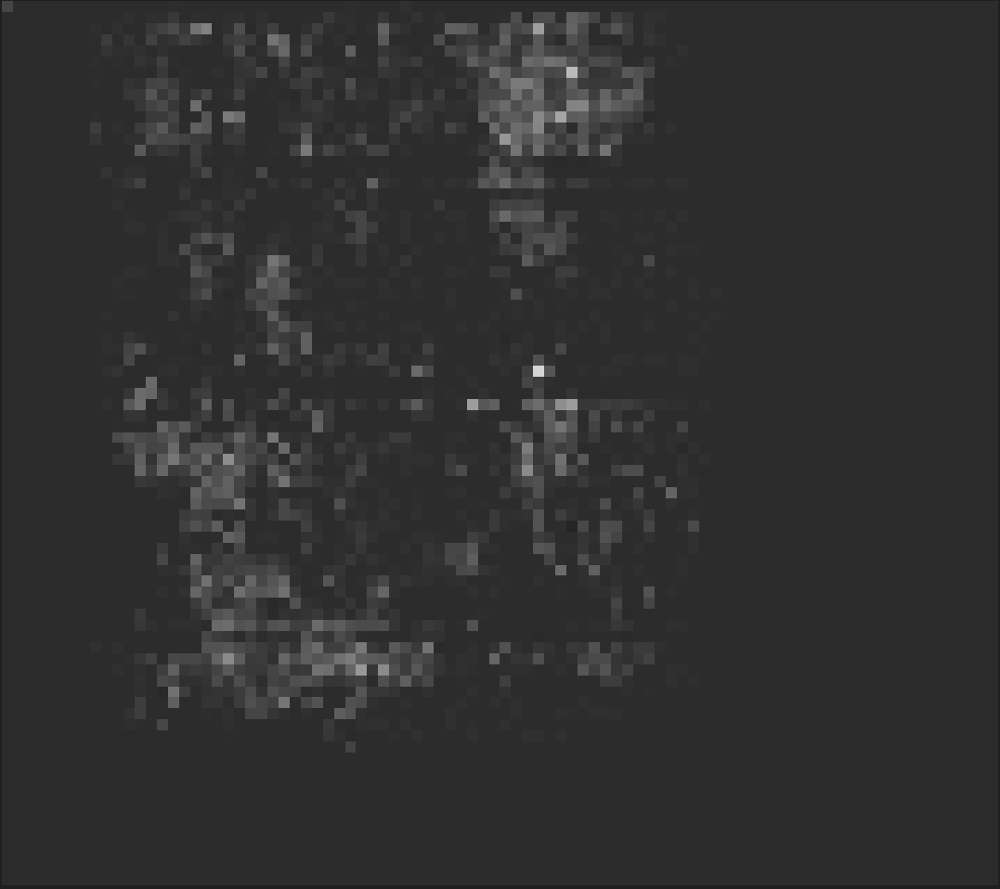
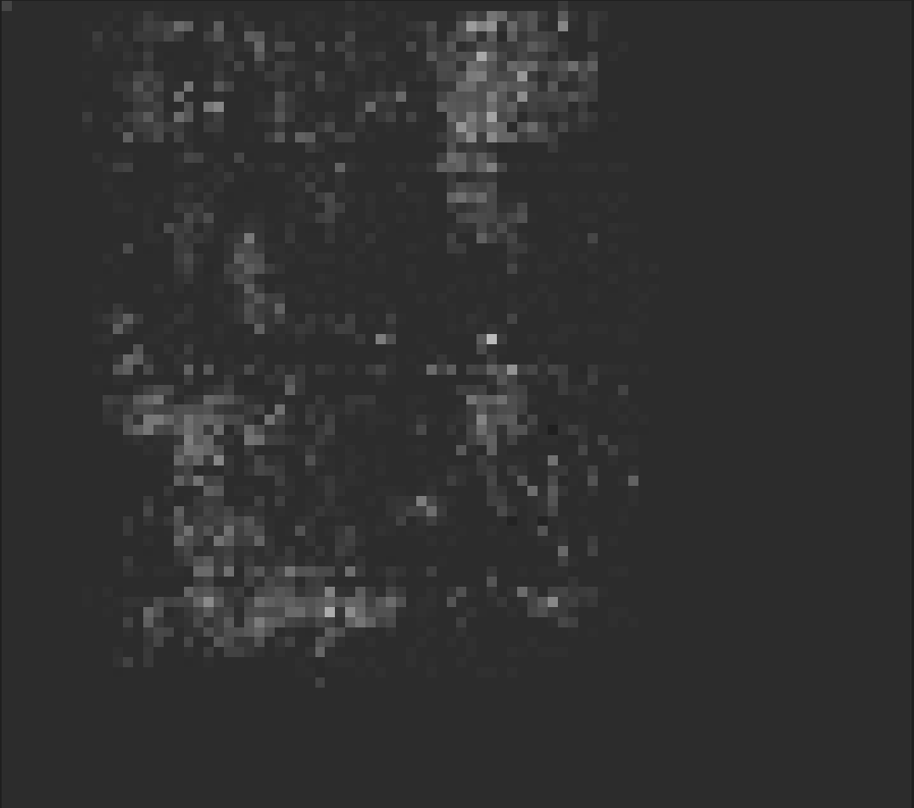
Generated Photon Images (10um x 10um per tile)
Using the emission model, we derived photon images for all 3000 current traces
Served as “photon traces” for optical side-channel analysis next
……
Trace 1
Trace 3000

Slide 18
ML-based Image Processing for Optical Side-channel Leakage Analysis
Data input
A set of per tile optical emission images of security operations from simulation, and the corresponding input data including per tile representative photon image
the white-box function model of the system under test
Optical side-channel leakage analytics
Use CNN for detecting per-tile photon intensity from per tile photon image
T-score can be derived and Correlation Optical Analysis can be performed can be used based on per-frame per-tile photon images
ML-based optical side-channel analysis can also be performed to speed up the cracking of the key
Ongoing work
We utilized the generated photon intensity for the following experiments, won’t affect the results much
Attacker-wise, it should be a grey value derived from the image (theoretically lossless extraction)

Slide 19
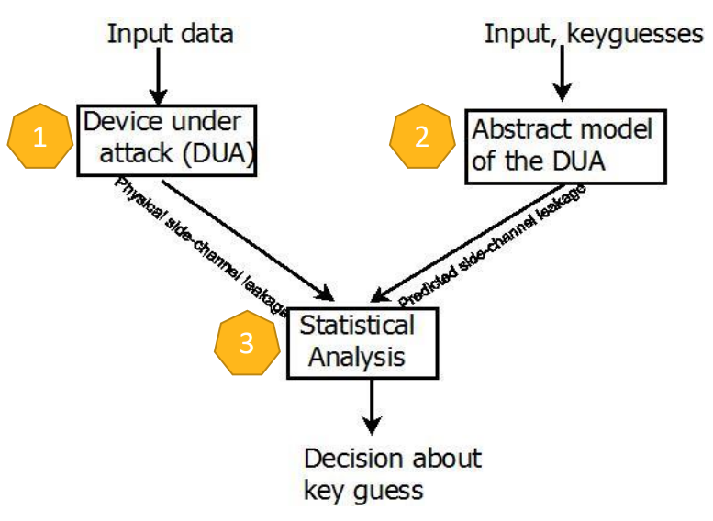
Correlation Power Analysis (CPA) Approach in RH-SC Security
We apply it on optical side-channel
Correlates the instantaneous power trace with input data + secret key
Given known input data and unknown key, simulate side-channel leakage in traces
Given known input data and all possible key guesses, predict side-channel leakage
Statistical correlation analysis: If the key guess is correct, then the correlation peak occurs between the predicted key and the true secret key
Disclaimer
Disclosure of long key bits is done at a small chunk with iterations.
Side-channel simulation can be noise-free to root cause and fix leakage
Side-channel simulation can also be noisy to approximate silicon leakage

Slide 20
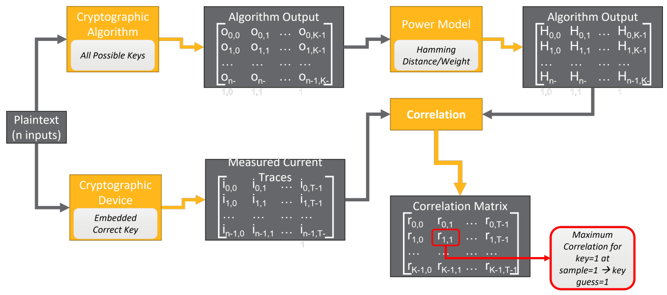
Known-Model Leakage Verification in RH-SC Security
In layout SCLA flow, the measured traces are the power waveforms from RedHawk-SC AnalysisView. The Security tool creates a power model by passing the plaintext inputs to the algorithm with all possible keys and calculate the algorithm output matrix based on selected Hamming Distance or Weight model. The tool now performs statistical correlation on two datasets to achieve a correlation matrix. The value with highest correlation corresponds to the correct key guess.
In our experiments, we used Hamming Weight model on AES 10th round Sbox output.
Generated I_{photon}

Slide 21
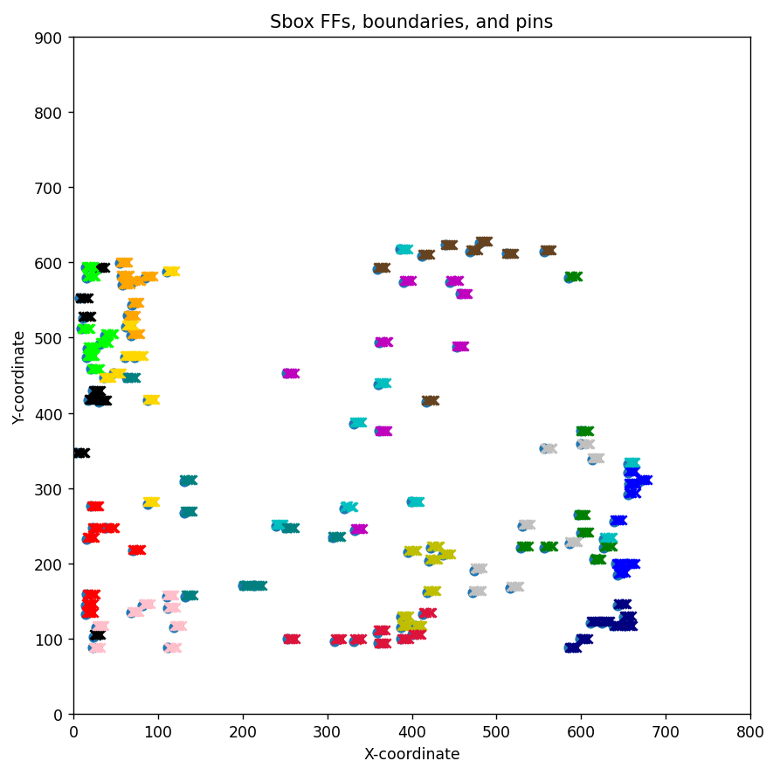
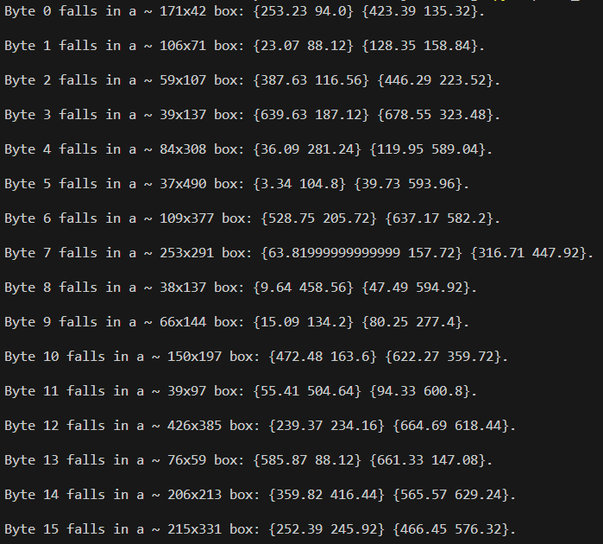
Split the Layout into Tiles
Actual Byte # in RH-SC results
Boundary enlarged ~0.5um for better tolerance
14
11
6
8
15
4
5
7
12
3
9
2
10
1
0
13

Slide 22
Split the Layout into Tiles
Actual Byte # in RH-SC results
Boundary enlarged ~0.5um for better tolerance
We try once with this given info of Sbox bytes’ boundaries, to verify our framework’s correctness
However, as attackers do not know the cell placements and boundaries
We scan through the layout and capture multiple images, each is a tile accumulating the photon current
Got results from 360 different tile-size arrangements
Sweep size_x from 20 to 400 um, step size: 20 um
Sweep size_y from 10 to 450 um, step size: 20 um

Slide 23
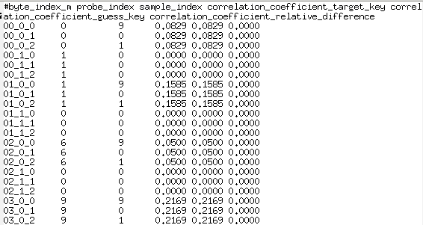
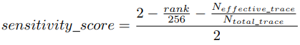
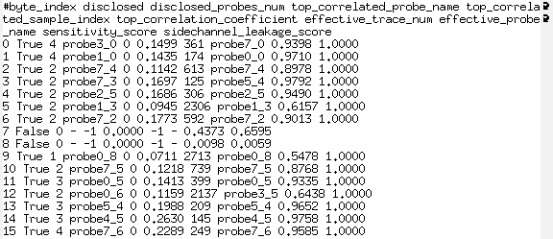
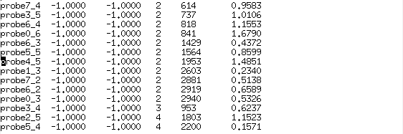
Experimental Results
For each tile_size run, we have:
Byte disclosure report
Probe disclosure report
Byte correlation report
Metrics
Byte correlation report
Byte disclosure report
Probe disclosure report
Notes:
Sensitivity score:
The rank is based on the ranking of the correct key at the end of inferencing. The rank = 0 for the disclosure case since the correct key has the top rank
The effective trace num is the number of traces used to disclose the key, and that equals the total trace num for the non-disclosure case.
So, the sensitivity score can fully describe all the cases, and a sensitivity score equal to or above 0.5 means full-key byte disclosure. If partial key bits are disclosed, the score is in a range of [0, 0.5)

Slide 24
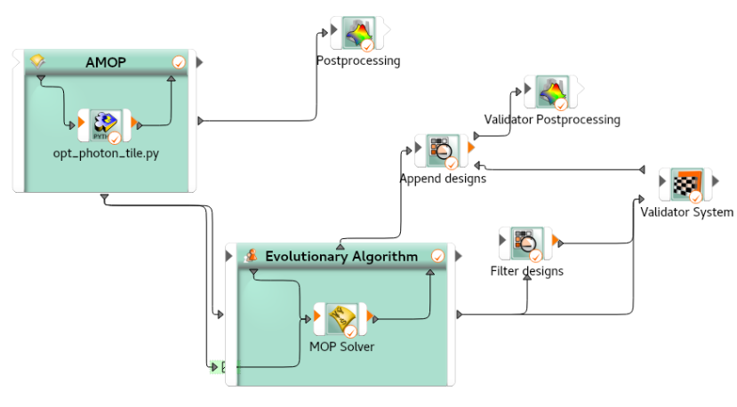
OptiSLang Flow - Apply Solver Wizard
Python script as a solver
Captures each features & labels’ value into variables
No need to print or output these values to any files, because optiSLang can identify them, as long as you have an independent naming for each.
Parameter (feature)
Size_x
Size_y
Can add an ‘offset’ in future work
Responses (labels)
Sensitivity score for each byte
Mean score for all 16 bytes
Amount of disclosed bytes

Slide 25
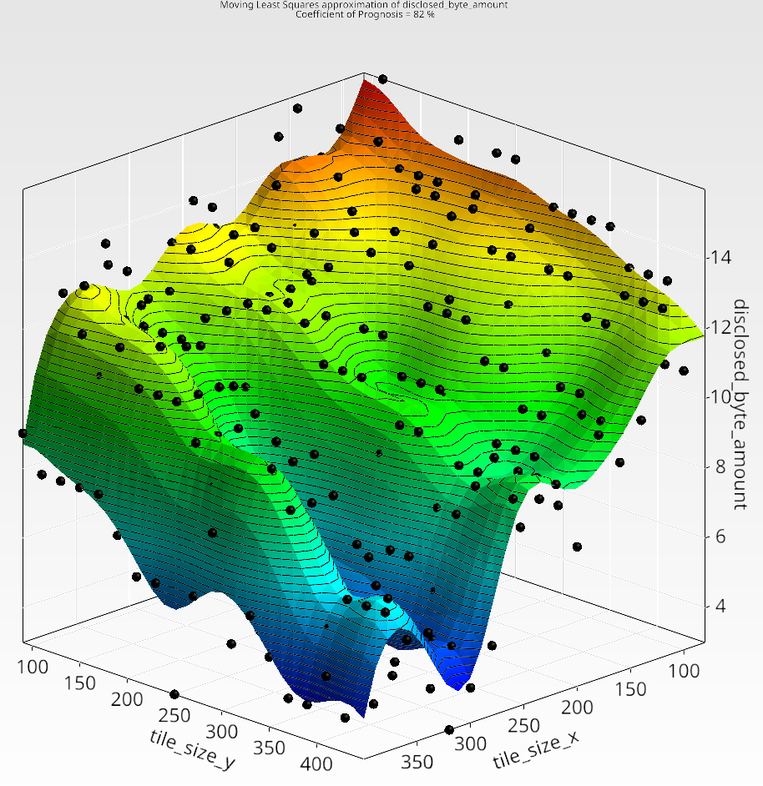
OptiSLang Flow - Apply Sensitivity and Optimization Wizard
Sensitivity analysis
Adaptive Metamodel of Optimal Prognosis (AMOP)
Sweep the parameter
size_x and size_y to cover all 360 cases I have
Optimization
Naturally inspired: evolutionary algorithm
Other available algorithms
Set the objective
Maximize the number of disclosed bytes
Can be easily changed to any other goal
What this will help? – to my understanding
Predict the results of any other given tile_size arrangements
If integrate the RHSC Security run and set an optimization goal, will probably save much run time, and outputs a trained model
Machine-learning rookies like me
# of disclosed bytes plotted over
tile size x, size y

Slide 26
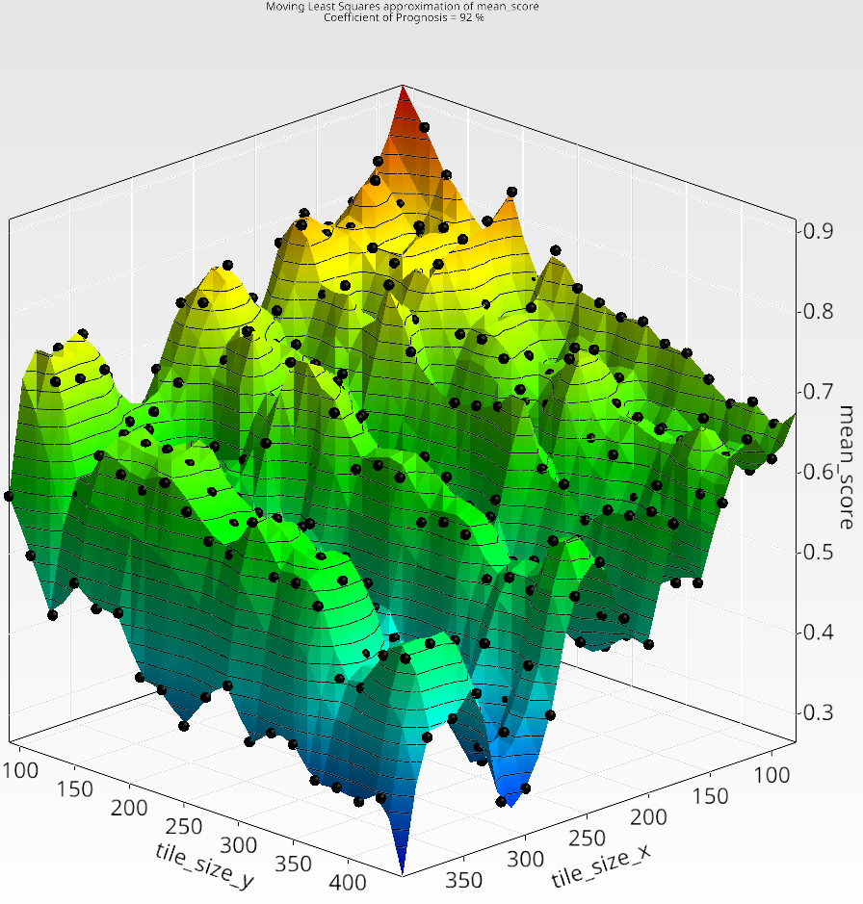
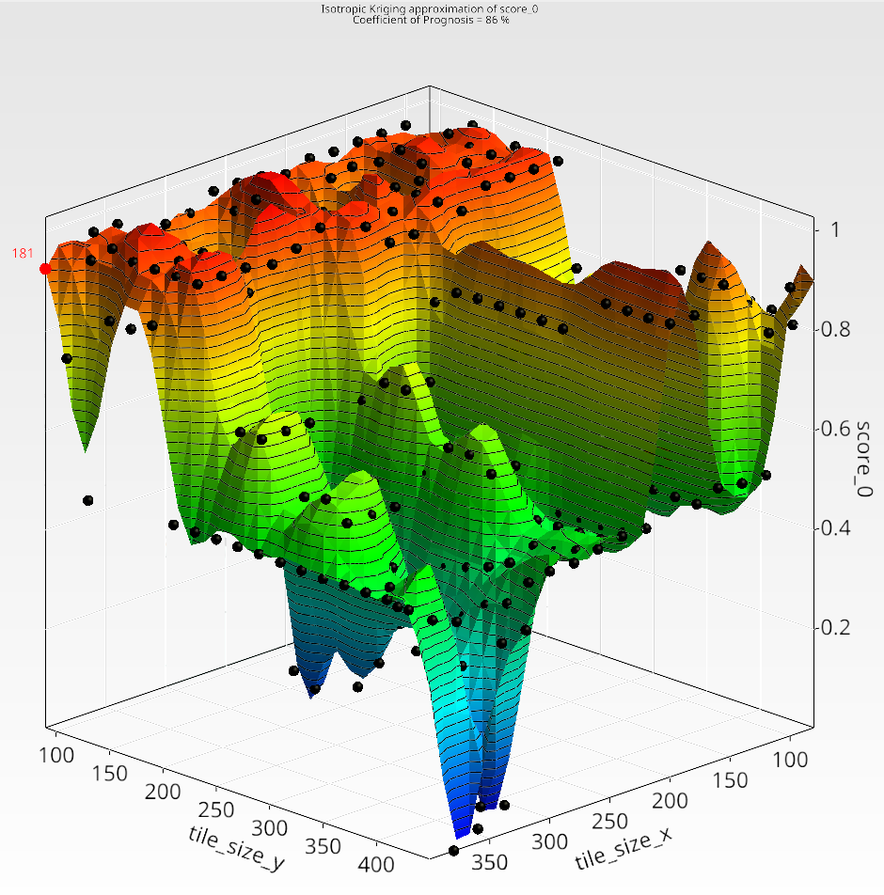
OptiSLang Flow - Apply Sensitivity and Optimization Wizard
mean_sensitivity_score
plotted over tile size x, size y
Sensitivity score of byte 0

Slide 27
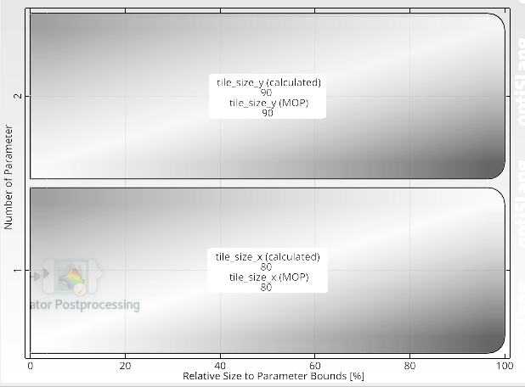
OptiSLang Flow - Apply Sensitivity and Optimization Wizard
Sensitivity analysis
Adaptive Metamodel of Optimal Prognosis (AMOP)
Sweep the parameter
size_x and size_y to cover all 360 cases I have
Optimization
Naturally inspired: evolutionary algorithm
Other available algorithms
Set the objective
Maximize the number of disclosed bytes
Can be easily changed to any other goal
What this will help? – to my understanding
Predict the results of any other given tile_size arrangements
If integrate the RHSC Security run and set an optimization goal, will probably save much run time, and outputs a trained model
Machine-learning rookies like me
Best tile size with optimizing goal of maximum # of disclosed bytes

Slide 28
Conclusion and Future Work
Conclusion
By modeling the photon emission behavior of NMOS, we presented a framework performing the optical side-channel analysis at layout-level of an AES chip.
The correlation between byte placement and optical side-channel leakage
Some placement features (e.g., mutual distances of FFs within a byte) can be added as sweeping parameters
There might be current coupling issues. Causing some pin current values totally in one byte’s boundary can crack another byte
The goal is to provide mitigation suggestions / security-aware placement constraints
Silicon results

Slide 29
Acknowledgement
Thanks to Norman, Lang, Sreeja for the awesome ideas, extended discussion, and tremendous help
Also thanks to Dylan and Bozidar on the contribution of photon emission theory and derivation of formula
Thanks to Kazuki-san, Nagata-san, Ying, and Pramod for the Totem flow: analyzing, selecting and collecting current traces. Also, the testcase of Kobe AES.
Thanks to Piin-Chen, Roger on the photon image generation, and discussion on the ML work
Thanks to Qiutong on the discussion of understanding semiconductor physics， Xiang on suggestions of efficient python on tile arrangements

Slide 30
Thank you!

Slide 32
Backup Slides:
Photon Emission Modeling

Slide 33
Photoemission in NMOS
Dylan McGuire, July 2023

Slide 34
Photon Emission Modeling
Photoemission is observed for NMOS devices when a channel current (Ids) is present
Physical process: hot carriers accelerated by high fields at the drain PN junction
Photon emission photos taken by PHEMOS-1000
Toriumi et al., IEEE TED 34, p1501 (1987)

Slide 35
Hot carriers
Different relaxation paths could be responsible
Intraband
Indirect c-c: impurity assisted (IA) or bremsstrahlung process (a)
Direct c-c: radiative emission from higher sub-bands (b)
Interband
Indirect c-v: phonon assisted (PA) e-h recombination (c)
Direct c-v: electron-hole recombination (d)
Early theory assumed IA c-c; spectral analysis & later theory suggests direct c-c
Intraband processes dominate, interband is negligible
Lacaita et al., IEEE TED 40, p577 (1993)

Slide 36
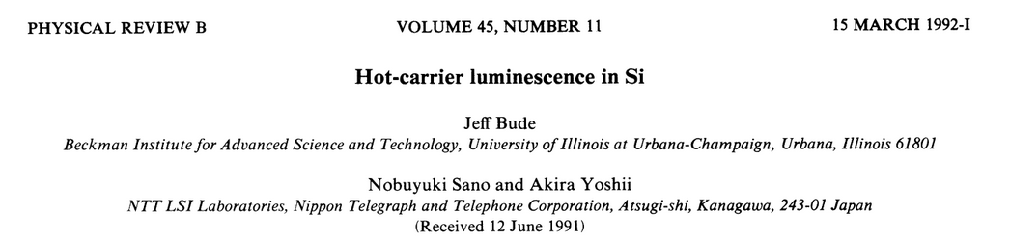
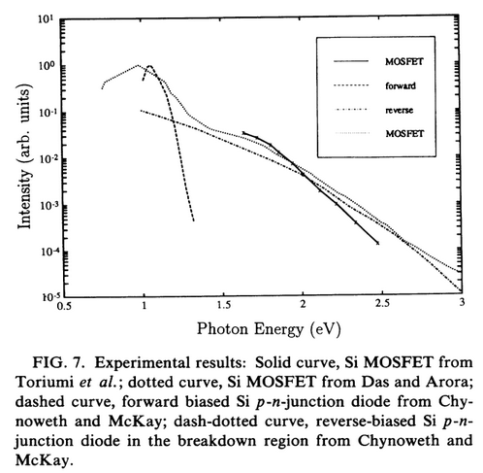
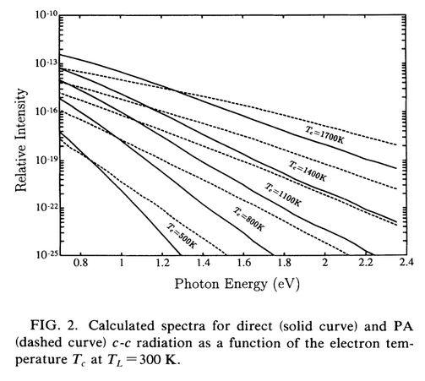
Spectra
Detailed band modeling indicates that intraband processes will dominate emission process & generate photons with a broad range of energies/wavelengths
Field-dependent electron temperature (Maxwell-Boltzmann statistics)
Energies range from <0.8 to >2.2eV (<560nm to >1550nm)
Bude et al., PRB 45, p5848 (1992)

Slide 37
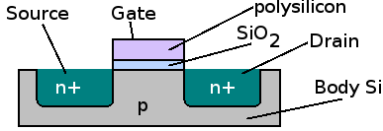
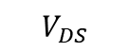
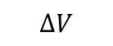
Summary
Photoemission in NMOS most likely due to intraband process involving hot carriers
High-field regime at drain PN junction
Expected that direct c-c processes will dominate
early models assume IA c-c (bremsstrahlung)
Broad spectrum of emission (560-1550nm)
-qV
$$ΔV$$
$$V_{DS}$$
(short channel)
x
L

Slide 38
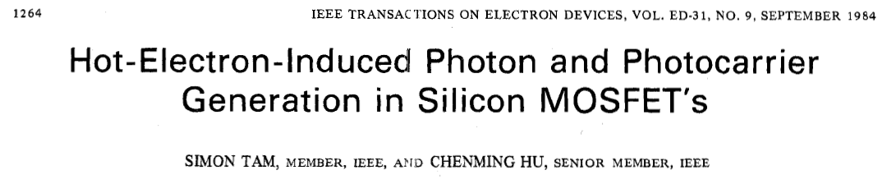
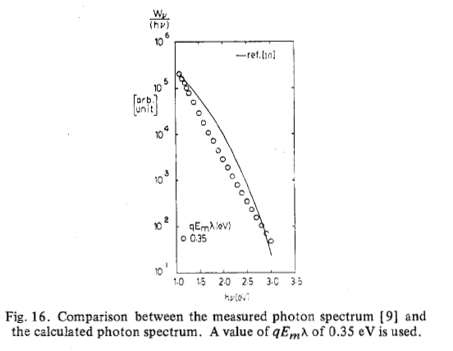
Hot-Electron Induced Photon Generation in Silicon NMOS
Model proposed by Tam & Hu
Assumes IA c-c process (optical phonon mediated relaxation)
Uses Maxwell Boltzmann statistics
Models scattering with mean free path parameter, field dependence
Validated by secondary measurement of photogenerated carriers collected in the collector & substrate
Tam & Hu, IEEE TED 31, p1264 (1984)

Slide 39
Hot-Electron Induced Photon Generation in Silicon NMOS
Model proposed by Tam & Hu
Assumes IA c-c process (optical phonon mediated relaxation)
Uses Maxwell Boltzmann statistics
Models scattering with mean free path parameter, field dependence
Validated by secondary measurement of photogenerated carriers collected in the collector & substrate
We’re assuming that this is an adequate substitute for a relaxation time that would be associated with an electron temperature under the same statistics, although the process is different (see Toriumi et al, eqs 7-9)
Tam & Hu, IEEE TED 31, p1264 (1984)

Slide 40
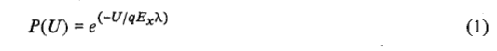
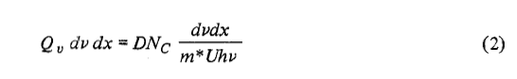






Formulation from Tam & Hu
Starts with probability of electron gaining excess kinetic energy $U$
Probability of emission with energy in $hν$ to $hν+dν$ is $Q_{ν}dν$
Rate of hot electrons passing through channel with energy $U$ to $U+dU$ (relates to Ids)
Spectrum of energy radiated on $ν$ to $ν+dν$ (eqs 5a & 6a)
Tam & Hu, IEEE TED 31, p1264 (1984)

Slide 41
Formulation from Tam & Hu
Integrating over frequency
Tam & Hu, IEEE TED 31, p1264 (1984)

Slide 42

Key parameters
Parameter | Units | Value | Description
$$D$$ | $$C^{6}$$ | $$2.8×{10}^{6}$$ | Constant
$$N_{C}$$ | $$m^{−3}$$ | $$5×{10}^{26}$$ | Impurity density in the drain (e.g. $5×{10}^{20}$cm⁻³)
$$m^{∗}$$ | $$kg$$ | $$0.26m_{0}$$ | Electron effective mass in silicon
$$λ$$ | $$m$$ | $$10nm$$ | Electron mfp
$$E_{m}$$ | $$V/m$$ | $$1−5×{10}^{7}$$ | Maximum electric field
$$\frac{dE_{x}}{dx}$$ | $$V/m^{2}$$ |  | Electric field gradient at the drain end of the channel
$$E_{g}$$ | $$eV$$ | $$1.12$$ | Silicon band gap energy
$$ν_{0}$$ | $$Hz$$ | $${qE}_{g}/h$$ | Cutoff frequency
$$a$$ | $$1$$ | $$0.30$$ | Constant
$$b$$ | $$eV$$ | $$0.16$$ | Constant

Slide 43
Modeling $E_{m}$ and $dE_{x}/dx$
Assume that the channel E-field near the drain can be modeled as a simple PN junction
Note $N_{D}≫N_{A}$, $n_{i}={10}^{10}cm^{−3}$ in silicon
Built-in voltage: $V_{0}=\frac{kT}{q}\ln\left(\frac{N_{A}N_{D}}{n_{i}^{2}}\right)$
Peak e-field: $E_{m}≃\sqrt{\frac{2q}{ε_{si}}V_{0}N_{A}}$
E-field gradient: $\frac{dE_{x}}{dx}≃\frac{E_{m}}{W}, W=\sqrt{\frac{2ε_{si}}{q}\frac{V_{0}}{N_{A}}}$
Channel/drain “diode”
$N_{D}^{+}$ (drain)
$N_{A}^{−}$ (ch)
x
$$E_{m}$$
$$E_{x}$$
x
$$x_{j}$$
$$x_{p}$$
$$x_{n}$$

Slide 44
Emission rate model
Final model is only linearly dependent on Ids
Assume $N_{A}=5×{10}^{16}cm^{−3}$ and $N_{D}=5×{10}^{20}cm^{−3}$ such that $E_{m}∼{10}^{5}V/{cm}$
$$I_{ν_{0},∞}\left(I_{DS}\right)=6.7×{10}^{−22}\left[J⋅s⋅C^{−1}\right] I_{DS}\frac{qN_{C}}{m^{∗}}\frac{qλE_{m}W}{E_{g}}\frac{a}{ν_{0}}e^{−{{(E}_{g}+b)}/{qE_{m}λ}} \left[s^{−1}\right]$$
Tam & Hu, IEEE TED 31, p1264 (1984)

